Slide 1

Project On Banking Management
Aman Gupta : 190973106021
Akarsh Aggarwal: 190973106015

Slide 2
INTRODUCTION
Banking management is the study of modern banking theories, banking regulations and legislations, savings and loan assessments, and international monetary aspects and policies.
The Banking Management suite provides a global accounting foundation that provides the all private banks with electronic banking facilities.
It allows client of private banks to carry out their day to day banking transactions.
The Banking Management project is widely applicable with private banks. It can even be used in industries for their personal transactions (working).

Slide 3
All the academic programs and activities at AMX Bank work towards one purpose - to help customer develop lives of significance for themselves and for others, true to the traditions of the BANK Motto "Service Before Self".
The mission of AMX Bank “to open doors and open minds” and prepare the ground for the future of the nation.
Bank relationship management provides processes and technology that help a company track and manage all their bank relationships by:
Providing a single view of all accounts and activities with a bank, worldwide. This includes bank accounts, insurance, lines of credit, and foreign exchange.
Providing a single view of authorization rights or each person and for each account, and the tools to set, terminate and manage those rights (provisioning the account).

Slide 4
OBJECTIVES
Banking System has three main objectives:
Changing Regulation of Banks.
Due to the bank failure, millions of depositors suffered from a great problem, as they didn’t get back their deposited money. To protect the interest of depositors, the deposit insurance scheme was made mandatory for banks.
Some of the techniques followed by the bank regulatory authorities to control the activities of commercial banks are:
Direction for the right price of bank services.
Introduction of deposit insurance.
Direction for adequate liquidity.
Direction for capital adequacy.
Direction for approval and non-approval of bank loan operation.
Increasing competition due to Changing development
The number of served clients and quality dimensions of services is the basis of competition. The bank, which provides better service with high quality, is capable of being successful in competition.

Slide 5
Two banks jointly create new services that provide the customers with a sustainable competitive advantage.
The bank, which can attract more clients, can create clients repeatedly. This technological environment absorbed more investment and new training.
Increasing competition due to Changing development
In the international banking business, the bank faces an extensive amount of legislation in the event of a new problem. International relations, global or bilateral, create more competition in the banking business.
Other factors, such as international trade and commerce, laws of found transfer, changes in social and cultural factors, establish a new operational management system that challenges the banking business.
All these factors stated make bank management more complex and challenging.

Slide 6
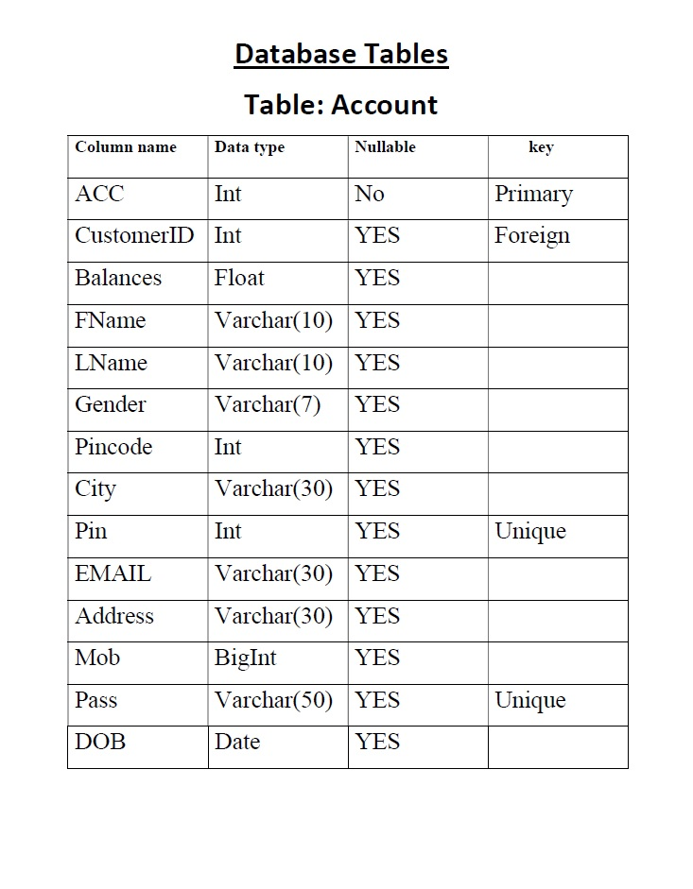
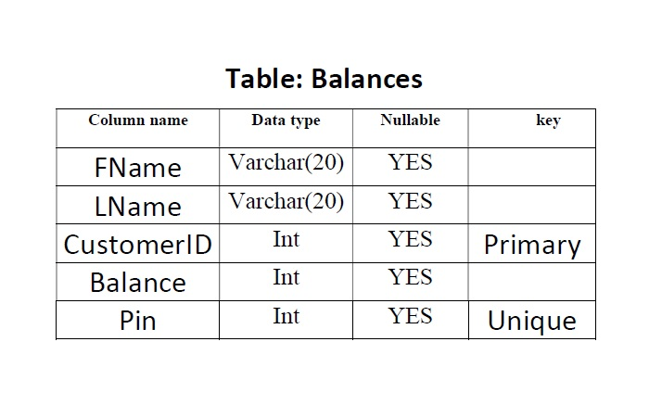
Database Table Design

Slide 7


INTERFACES
1. Loading page
2. WELCOME PAGE OF PROJECT

Slide 8
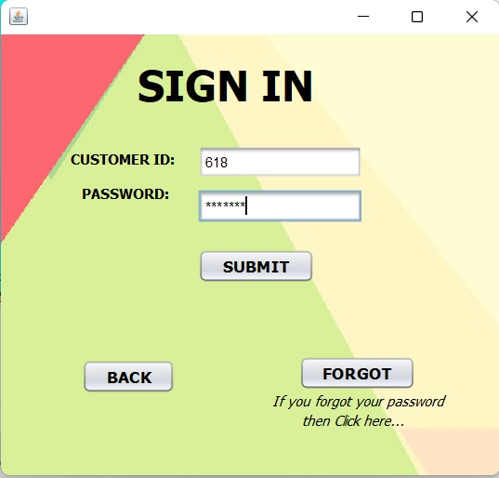
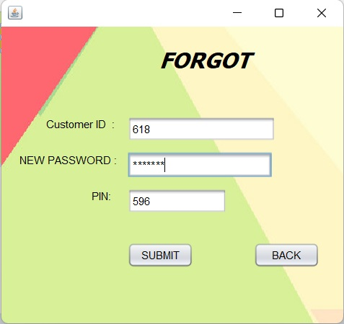
INTERFACES
3.CUSTOMER LOGIN PAGE
4.FORGOT PAGE

Slide 9
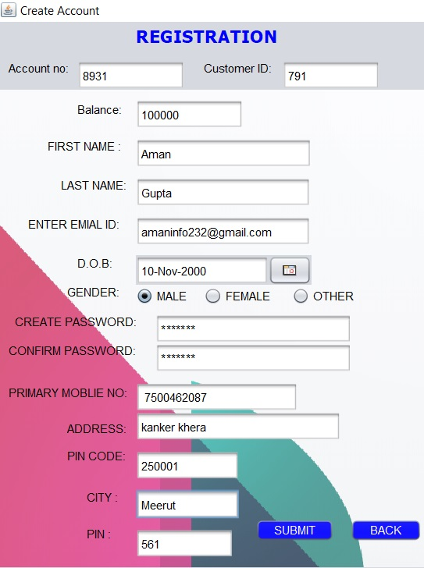
INTERFACES
5.CUSTOMER SIGNUP PAGE
This page for recovering password.

Slide 10
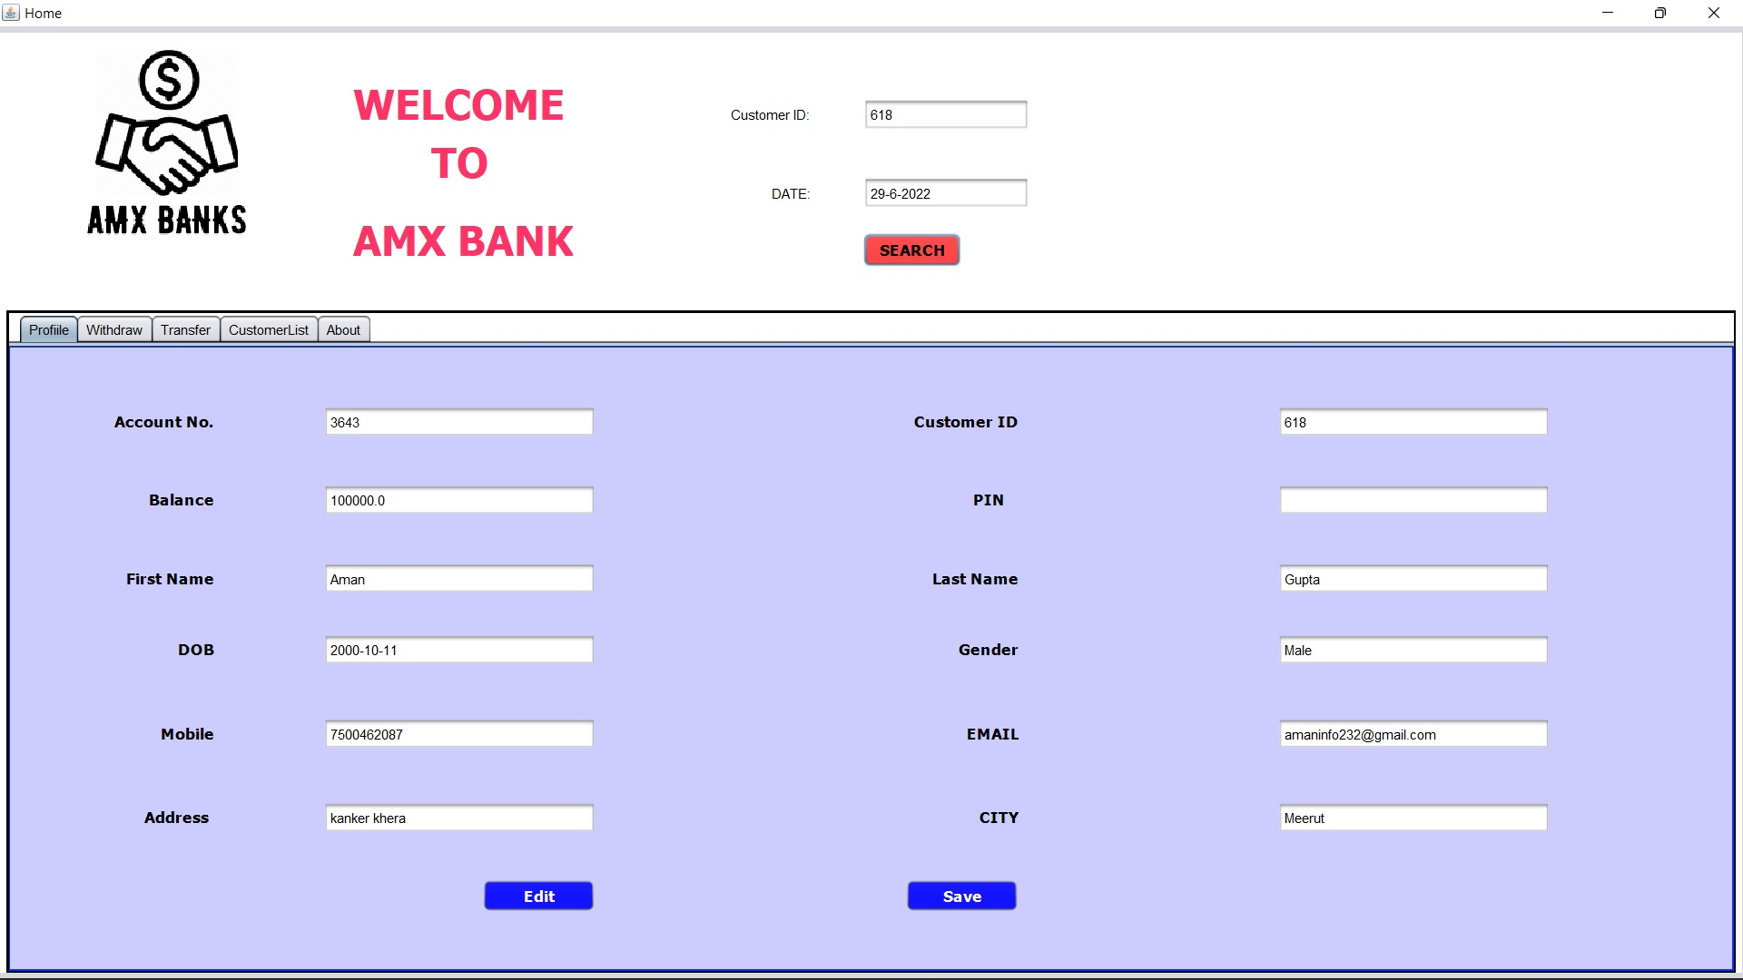
INTERFACES
6. MENU PAGE 1st
You can see the Profile of user.

Slide 11
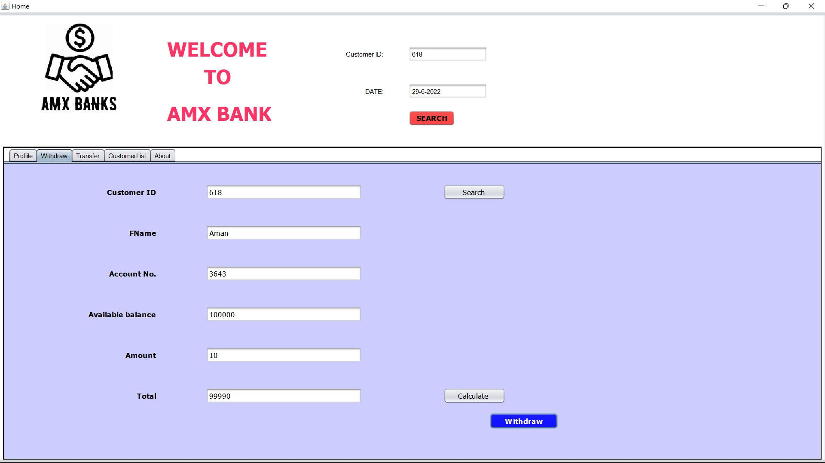
INTERFACES
7. MENU PAGE 2nd
You can withdrawal of money

Slide 12
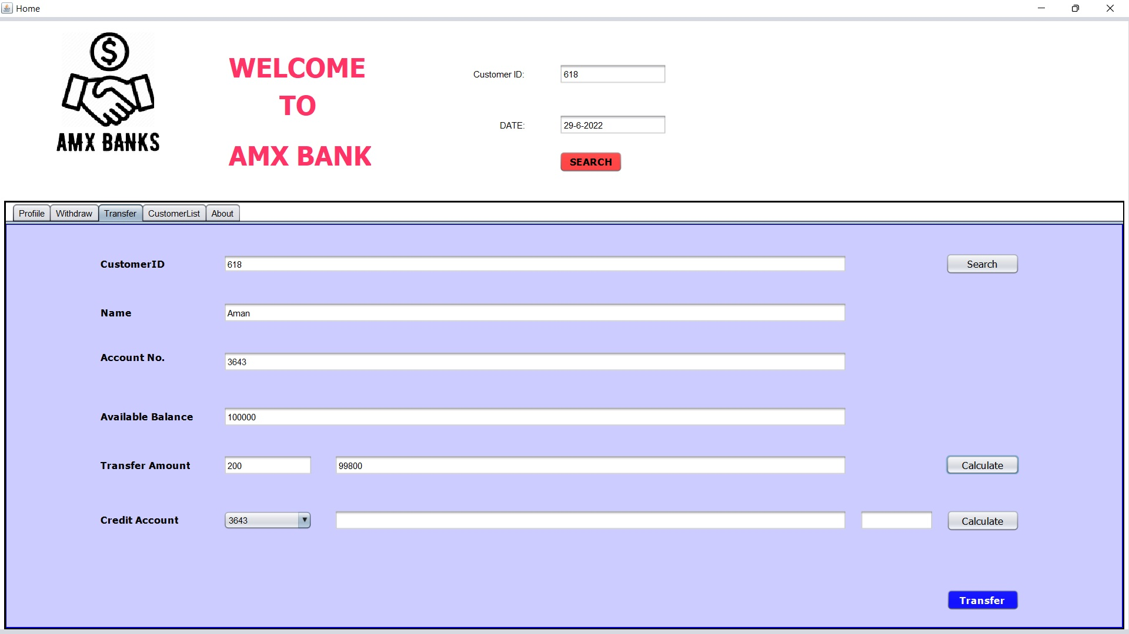
INTERFACES
8. MENU PAGE 3rd
You can transfer the money

Slide 13
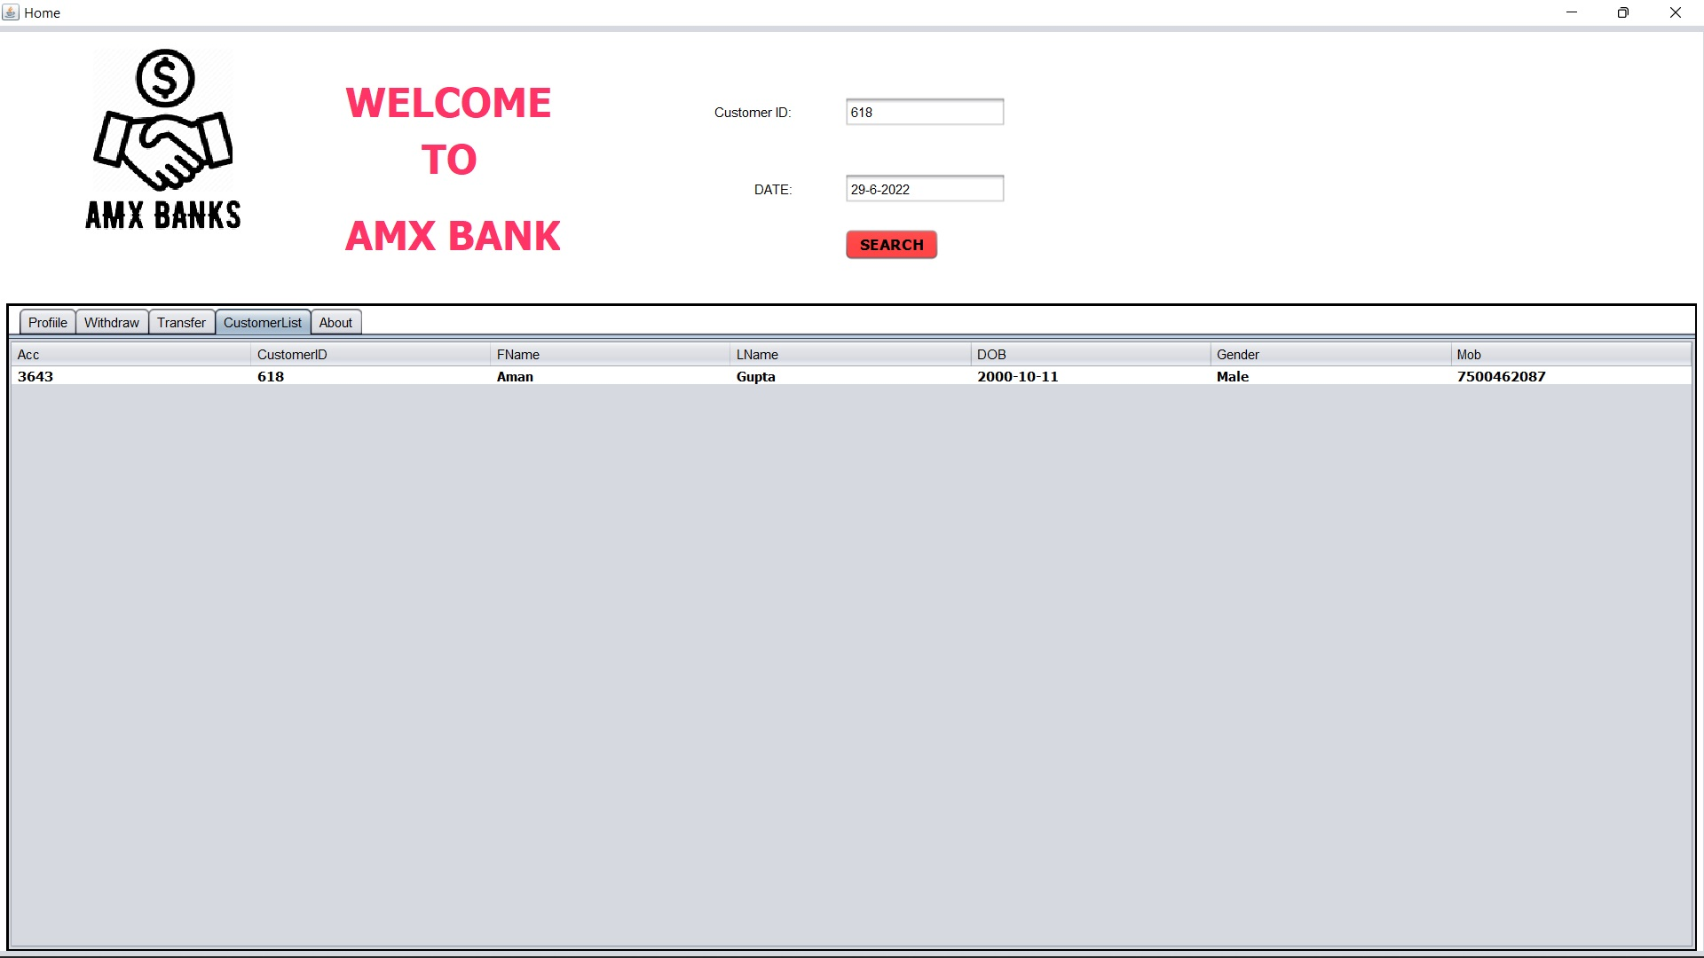
INTERFACES
9. MENU PAGE 4th
You can seen information about the customer.

Slide 14
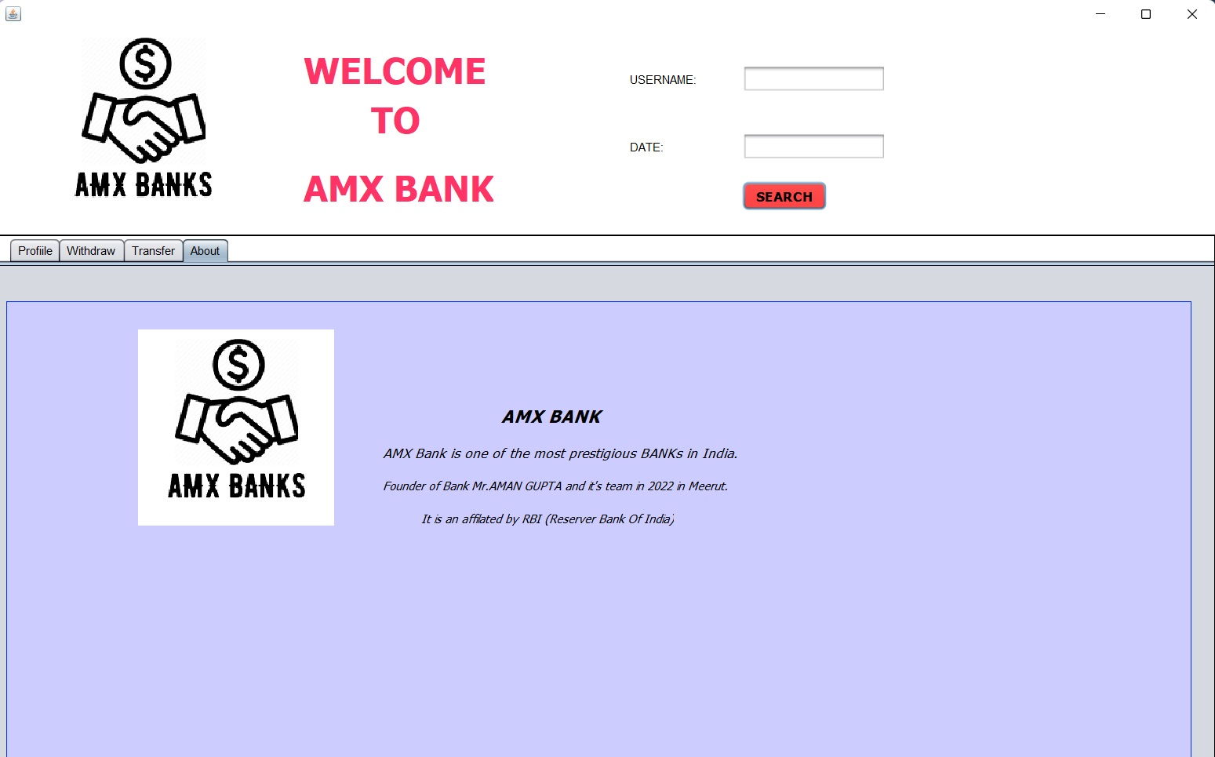
INTERFACES
10. MENU PAGE 5th
You can seen Description of the Application.

Slide 15
FUTURE SCOPE
The system can be designed for further enhancement .This could also be developed according to the growing needs of the customer.
This, coupled with growing regulatory pressures, is forcing businesses to protect the integrity, privacy and security of critical information.
An increasing demand for a digital banking experience from millennials and Gen Zers is transforming how the entire banking industry operates.
Consumers’ growing desire to access financial services from digital channels has led to a surge in new banking technologies that are reconceptualizing the banking industry.

Slide 16
CONCLUSION
This project developed, incorporated all the activities involved in the browsing centre.
It provides all necessary information to the management as well as the customer with the use of this system; the user can simply sit in front of the system and monitor all the activities without any physical movement of the file. Management can service the customers request best in time.
The system provides quickly and valuable information. These modules have been integrated for effective use of the management for future forecasting and for the current need.

Slide 17


